Slide 1
OUR ICBM LEGACY ATLAS TO SENTINEL VERSION 5.0
ADD PRESENTER NAME
ADD DATE
PK, MM III, and MM IB at F. E. Warren AFB

Slide 2
AGENDA
THE IMPORTANCE OF DETERRENCE AND THE ICBM
BACKGROUND
ATLAS
TITAN I
TITAN II
MINUTEMAN
PEACEKEEPER
TREATIES
CURRENT ICBM FORCE
SENTINEL

Slide 3
THE IMPORTANCE OF DETERRENCE
The Threat
During the Cold War and the birth of Intercontinental Ballistic Missiles (ICBMs), the Soviet Union was the main threat.
Today, the US and our allies face a complex and deteriorating threat environment; one where adversaries increasingly rely on nuclear weapons in their strategy.
Great power competition has returned as the mainstay of national defense strategy.
The United States now faces two nuclear-armed peer adversaries, as well as regional powers, who all have to be deterred differently, all at the same time.
Deterrence
The fundamental nature of deterrence is about decisively influencing an adversary's decision calculus regarding strategic attack or the escalation of a conflict.
We deter attacks by ensuring the expected lack of success and perspective costs far outweigh any achievable gains by the adversary.
Nuclear weapons, and ICBMs in particular, play a critical role in strategic deterrence.
The Nuclear Triad
The US maintains a triad of nuclear forces consisting of ICBMs, Submarine Launched Ballistic Missiles (SLBMs), and bombers.
Each leg of the triad provides unique and complementary attributes. Collectively, the triad is intended to ensure that no adversary believes it could launch a strategic attack under any circumstances that eliminates the US ability to respond and inflict unacceptable damage.

Slide 4
THE IMPORTANCE OF THE ICBM
Most responsive leg of the nuclear triad
ICBMs are continuously on-alert...they are the backbone of the day-to-day nuclear deterrent.
ICBMs can be rapidly retargeted and launched.
ICBMs provide the President flexible, adaptable, and responsive options.
ICBMs have multiple constant and robust communications pathways that ensures the ICBM force will always receive the President’s orders.
Strategically Stabilizing
With its dispersed and hardened basing mode, its sheer numbers (400 missiles and 45 Launch Control Centers), resilient command & control, responsiveness, and robust communications, the ICBM force provides an insurmountable targeting challenge to adversaries and raises the threshold for nuclear use against the US to an extraordinarily high level.
- Since the beginning, a common goal for ICBM basing throughout its history has been an evolution of increased hardening and dispersal, as well as making ICBM command, control, and communications systems more resilient.
Without ICBMs, an adversary would be faced with only five targets to destroy inside the United States (two submarine bases and three bomber bases)...while still unlikely, an enemy first strike on the US would be much easier to plan and execute.
On alert day-to-day, so no need to generate the whole ICBM force during unexpected and rapidly changing crises.
Provides cover while the bombers generate to alert and additional submarines are sent to sea during a crisis.

Slide 5
ICBM DEPLOYED LOCATIONS PAST AND PRESENT
Fairchild
Larson
Malmstrom
Minot
Grand Forks
Plattsburgh
Mt. Home
Ellsworth
Beale
F. E. Warren
Lincoln
Offutt
Lowry
Schilling
Vandenberg
McConnell
Forbes
Whiteman
Altus
Little Rock
Atlas
Titan I
Titan II
Minuteman
Peacekeeper
Walker
Davis-Monthan
Dyess

Slide 6
ATLAS D – 30 DEPLOYED
Missile: CGM-16D (originally SM-65D)
Fuel: Liquid
Warhead: One Mk-2 or Mk-3
Guidance: Radio Inertial Guidance (relied on ground-based systems for guidance during flight)
Site Plan: At Vandenberg, there were two different types of sites. Initially, as an emergency measure, the first site built (576A) had missiles stored on above-ground gantries along with their support buildings. A second site (576B) was also built similar to the sites located at Offutt and F.E. Warren, where missiles were stored horizontally in above-ground “coffin” launchers. At these sites, there were three missiles and one control center per complex.
Deployment: 576 SMS: three missiles per complex with two distinct complexes in the squadron; 564 SMS: three missiles per complex with two complexes in the squadron (3 x 2) clustered around a central guidance control facility; 565 SMS & 549 SMS: three missiles per complex and three complexes in each squadron (3 x 3)
Launch Mode: At the Vandenberg gantry site, launched directly from gantry. At the remaining “coffin” launcher sites, the missiles were raised vertically, fueled, and then launched.
Crew Size: Six; Launch Officer, Guidance Officer, Missile Maintenance Technician, Ballistic Missile Analyst Technician, Guidance Technician, and Power Production Technician. Crews at the Vandenberg gantry site were considerably larger.
Interesting Fact: The Atlas was the nation’s first operational ICBM with the first missile being placed on alert on 31 October 1959. The popular WD-40 can trace its origin to the Atlas ICBM. Convair, an aerospace contractor, first used WD-40 to protect the outer skin of the Atlas ICBM from rust and corrosion.
Vandenberg AFB, CA 1959-1964 576 SMS
F. E. Warren AFB, WY 1960-1964 564 SMS, 565 SMS
Offutt AFB, NE 1961-1964 549 SMS

Slide 7
ATLAS D DEPLOYED LOCATIONS
F. E. Warren
Offutt
Vandenberg

Slide 8
ATLAS D – VANDENBERG AFB, CA
576th Strategic Missile Squadron
Site 576A had three missiles in above-ground gantry sites. Site 576B had three missiles in above-ground “coffin” launchers. The squadron was on-alert from 1959 to 1964.

Slide 9
ATLAS D – VANDENBERG AFB, CA
The Strategic Air Command showcasing its newest weapons systems: the B-52 bomber and Atlas D ICBM. Pictured here are Atlas D missiles from the 576th SMS on alert at site 576A circa early 1960s. Both missiles are armed with Mk-2 warheads.

Slide 10
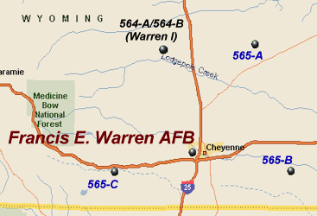
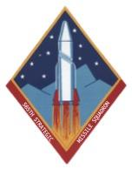
ATLAS D – F.E. WARREN AFB, WY
564th Strategic Missile Squadron
Three missiles per complex with two complexes in the squadron (3x2) clustered around a central guidance control facility. The squadron was on-alert from 1960 to 1964.
565th Strategic Missile Squadron
Three missiles and one Launch Control Center per complex with three complexes in the squadron (3x3) dispersed away from each other. The squadron was on-alert from 1960 to 1964.

Slide 11
ATLAS D – F.E. WARREN AFB, WY
An overhead photo of 564th SMS sites A and B clustered together around a central guidance control facility. Later sites were not clustered together like this in order to be more survivable.

Slide 12
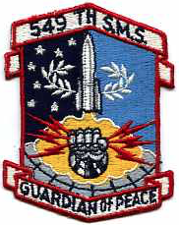
ATLAS D – OFFUTT AFB, NE
549th Strategic Missile Squadron
Three missiles and one Launch Control Center per complex with three complexes in the squadron (3x3) dispersed away from each other. The squadron was on alert from 1961 to 1964. Complex 549-C was actually located in Iowa. Originally, the 566th SMS was activated to control Offutt’s Atlas D missiles. However, in 1961 the 566th SMS at Offutt and 549th SMS at F.E. Warren switched designations to comply with lineage rules.

Slide 13
ATLAS D – OFFUTT AFB, NE
A 549th SMS Atlas D site, probably 549-C in Iowa.

Slide 14
ATLAS D
A series of photos showing the sequence of events of how the Atlas D missile goes from being stored horizontally in its “coffin” launcher, raised to the vertical position, fueled, and then launched.

Slide 15
ATLAS D
An Atlas D missile raised to the vertical position.

Slide 16
ATLAS D
Diagram demonstrating how the Atlas D radio inertial guidance system worked. The missile would send location signals down to the ground-based radio antenna, which would then in turn provide course correction information via radio signal. This type of guidance was vulnerable to enemy interference, so future generations of ICBMs moved to an all-internal guidance system.

Slide 17
ATLAS E – 27 DEPLOYED
Missile: CGM-16E (originally SM-65E)
Fuel: Liquid
Warhead: One Mk-4
Guidance: All-Inertial (moved away from relying on ground-based systems for guidance during flight)
Site Plan: Missiles deployed singly with one control center per missile. Missiles were stored horizontally in “coffin” launchers. Roofs were at ground level in order to be more survivable than above-ground Atlas D sites.
Deployment: One missile per complex with nine missiles per squadron (1 x 9)
Launch Mode: Raised from horizontal to vertical position, fueled, and then launched.
Crew Size: Five; Missile Combat Crew Commander, Deputy Missile Combat Crew Commander, Ballistic Missile Analyst Technician, Missile Maintenance Technician, and Power Production Technician.
Interesting Facts: The major advancement for Atlas E was an all-inertial guidance systems which obviated the need for ground based radar control stations. Also, Atlas E was deployed in a more hardened and dispersed mode than Atlas D.
Fairchild AFB, WA 1961-1965 567 SMS
Forbes AFB, KS 1961-1965 548 SMS
F. E. Warren AFB, WY 1961-1965 566 SMS

Slide 18
ATLAS E DEPLOYED LOCATIONS
Fairchild
F. E. Warren
Forbes

Slide 19
ATLAS E – FAIRCHILD AFB, WA
567th Strategic Missile Squadron
One missile and one Launch Control Center per complex with nine complexes in the squadron (1x9) dispersed away from each other. Complex 567-3 was actually located in Idaho. The squadron was on-alert from 1961 to 1965.

Slide 20
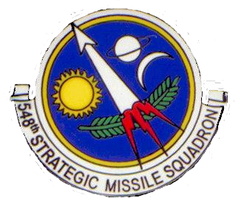
ATLAS E – FORBES AFB, KS
548th Strategic Missile Squadron
One missile and one Launch Control Center per complex with nine complexes in the squadron (1x9) dispersed away from each other. The squadron was on-alert from 1961 to 1965.

Slide 21
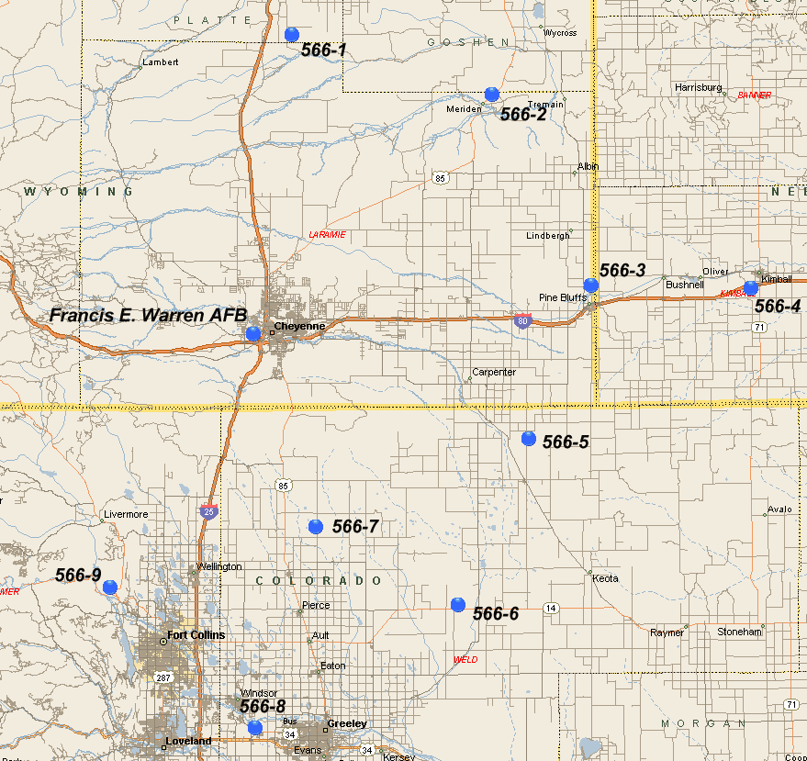
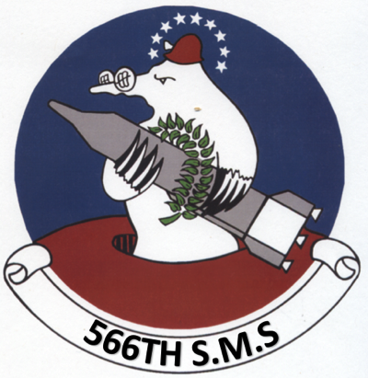
ATLAS E – F.E. WARREN AFB, WY
566th Strategic Missile Squadron
One missile and one Launch Control Center per complex with nine complexes in the squadron (1x9) dispersed away from each other. They were spread out across the three states of Wyoming, Nebraska, and Colorado. The squadron was on-alert from 1961 to 1965. Originally, the 566th SMS was activated to control Offutt’s Atlas D missiles. However, in 1961 the 566th SMS at Offutt and 549th SMS at F.E. Warren switched designations to comply with lineage rules. Due to mutual agreement between the two units, the 549th SMS retained the original emblem and the 566th (now at F.E. Warren) created the emblem seen above.

Slide 22
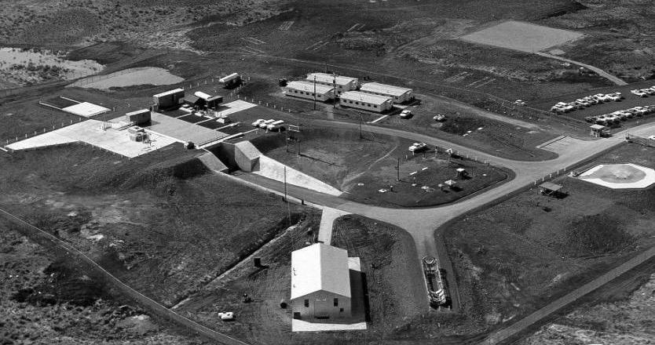
ATLAS E
An aerial view of a typical Atlas E site. Notice how most of the “coffin” launcher (green arrow) is buried underground versus the all above-ground Atlas D sites. The movable “coffin” launcher door is flush with ground level.

Slide 23
ATLAS E
Another aerial view of a typical Atlas E site. Notice how most of the “coffin” launcher is buried underground versus the all above-ground Atlas D sites. The movable “coffin” launcher door is flush with ground level.

Slide 24
ATLAS E
An Atlas E crew on alert in the Launch Control Center. Missileers originally wore white coverall uniforms until 1967, when they transitioned to two-piece blue uniforms.

Slide 25
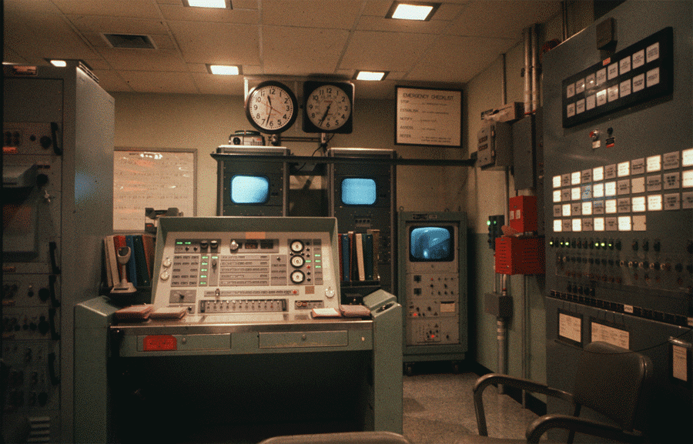
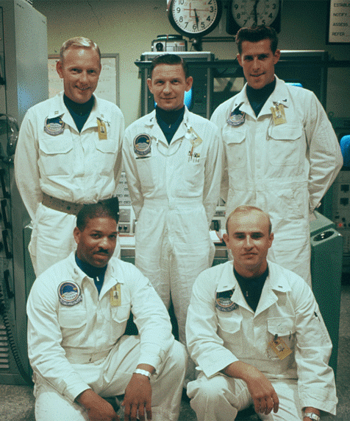
ATLAS E
A 567th SMS Atlas E crew from Fairchild AFB, WA.
A view of the Launch Console in an Atlas E Launch Control Center.

Slide 26
ATLAS E
An Atlas E missile stored horizontally inside its “coffin” launcher with the roof closed. Atlas missiles were stored empty and were only fueled prior to launch. An Atlas missile would collapse under its own weight if left empty, so the tanks were pressurized with nitrogen gas in order to prevent them from collapsing in on themselves.

Slide 27
ATLAS E
An Atlas E raised to the vertical position with the roof door open. The missile would then be fueled prior to launch.

Slide 28
ATLAS F – 72 DEPLOYED
Missile: HGM-16F (originally SM-65F)
Fuel: Liquid
Warhead: One Mk-4
Guidance: All-Inertial
Site Plan: One missile stored vertically in below-ground silo with adjoining control center.
Deployment: One missile per complex with twelve complexes per squadron (1 x 12)
Launch Mode: Missile was fueled, raised to surface via a silo elevator, and then launched.
Crew Size: Five; Missile Combat Crew Commander, Deputy Missile Combat Crew Commander, Ballistic Missile Analyst Technician, Missile Facilities Technician, and Electrical Power Production Technician.
Interesting Facts: The Atlas F was the first ICBM to be stored vertically in below-ground silos. This made it a more hardened and survivable weapon system over Atlas D and E.
Schilling AFB, KS 1962-1965 550 SMS
Plattsburgh AFB, NY 1962-1965 556 SMS
Walker AFB, NM 1962-1965 579 SMS
Lincoln AFB, NE 1962-1965 551 SMS
Altus AFB, OK 1962-1965 577 SMS
Dyess AFB, TX 1962-1965 578 SMS

Slide 29
ATLAS F DEPLOYED LOCATIONS
Plattsburgh
Lincoln
Schilling
Walker
Altus
Dyess

Slide 30
ATLAS F – SCHILLING AFB, KS
550th Strategic Missile Squadron
One missile and one Launch Control Center per complex with twelve complexes in the squadron (1x12) dispersed away from each other. The squadron was on-alert from 1962 to 1965.

Slide 31
ATLAS F – PLATTSBURGH AFB, NY
556th Strategic Missile Squadron
One missile and one Launch Control Center per complex with twelve complexes in the squadron (1x12) dispersed away from each other. Complexes 556-2 and 556-3 were actually located in Vermont. The squadron was on-alert from 1962 to 1965.

Slide 32
ATLAS F – WALKER AFB, NM
579th Strategic Missile Squadron
One missile and one Launch Control Center per complex with twelve complexes in the squadron (1x12) dispersed away from each other. The squadron was on-alert from 1962 to 1965.

Slide 33
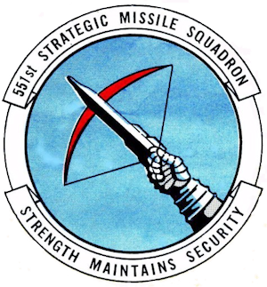
ATLAS F – LINCOLN AFB, NE
551st Strategic Missile Squadron
One missile and one Launch Control Center per complex with twelve complexes in the squadron (1x12) dispersed away from each other. The squadron was on-alert from 1962 to 1965.

Slide 34
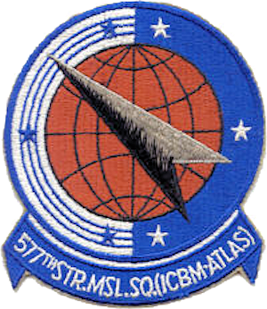
ATLAS F – ALTUS AFB, OK
577th Strategic Missile Squadron
One missile and one Launch Control Center per complex with twelve complexes in the squadron (1x12) dispersed away from each other. The squadron was on-alert from 1962 to 1965.

Slide 35
ATLAS F – DYESS AFB, TX
578th Strategic Missile Squadron
One missile and one Launch Control Center per complex with twelve complexes in the squadron (1x12) dispersed away from each other. The squadron was on-alert from 1962 to 1965.

Slide 36
ATLAS F
An overview of an Atlas F site with the Launch Control Center connected to the missile silo via an underground tunnel. The missile was stored vertically in the silo day-to-day. If there was a launch order, the missile would be fueled, raised to the surface via an elevator, and then launched. This system and process allowed the Atlas F missile to be more protected prior to launch than previous versions of the Atlas missile.

Slide 37
ATLAS F
An Atlas F raised to the surface from its silo. The “smoke” seen is actually Liquid Oxygen (LOX) being vented. The LOX is normally stored at extremely low temperatures, where it is the most stable. When the missile is fueled, the LOX will begin to warm up and boil. This increases pressure inside the missile, so the excess pressure needs to be released in order to prevent damage to the missile.

Slide 38
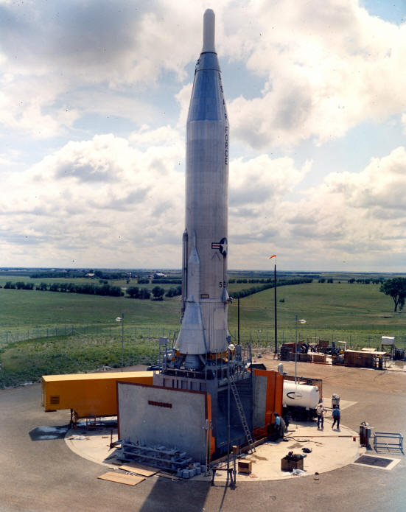
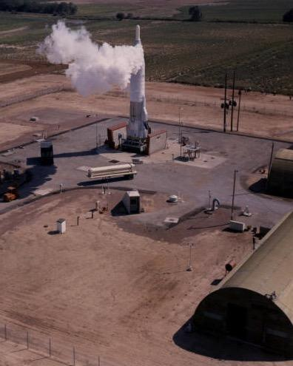
ATLAS F
Atlas F in raised position. Note the silo doors.
Atlas F in raised position. Note the LOX being vented, which means this missile is fueled.

Slide 39
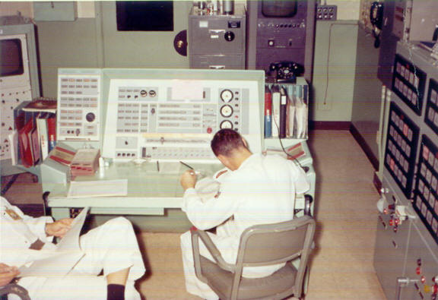
ATLAS F
Atlas F crew sitting at the Launch Control Console in the Launch Control Center.

Slide 40
TITAN I – 54 DEPLOYED
Missile: HGM-25A (originally SM-68A)
Fuel: Liquid Propellant
Warhead: One Mk-4
Guidance: Radio Inertial Guidance (relied on ground-based systems for guidance during flight)
Site Plan: Each complex had three missile silos, one control center, propellant storage and equipment buildings, a powerhouse, and radio guidance antenna silos all below-ground and connected via tunnels.
Deployment: Three missiles per complex with three complexes per squadron (3 x 3)
Launch Mode: Missiles were fueled and then raised to surface via a silo elevator, along with the radio guidance antennas, and then launched one at a time.
Crew Size: Six; Missile Combat Crew Commander, Missile Launch Officer, Guidance Electronics Officer, Ballistic Missile Analyst Technician, and two Electrical Power Production Technicians.
Interesting Fact: Since putting ICBMs on alert at the earliest possible date was a national priority, the Titan I was developed almost concurrently with the Atlas ICBM just in case the Atlas proved to be inviable. The Titan I was the last ICBM to use radio inertial guidance. Newer ICBMs relied upon all-inertial guidance systems which were more secure and not susceptible to enemy interference.
Lowry AFB, CO 1962-1965 724 SMS, 725 SMS*
Mountain Home AFB, ID 1962-1965 569 SMS
Beale AFB, CA 1962-1965 851 SMS
Larson AFB, WA 1962-1965 568 SMS
Ellsworth AFB, SD 1962-1965 850 SMS
*The two squadrons at Lowry AFB were originally activated as the 848th and 849th SMS. However, on 1 July 1961, SAC disbanded those squadrons and replaced them with the 724th and 725th SMS, prior to the Titan Is going on alert.

Slide 41
TITAN I DEPLOYED LOCATIONS
Larson
Mt. Home
Ellsworth
Beale
Lowry

Slide 42
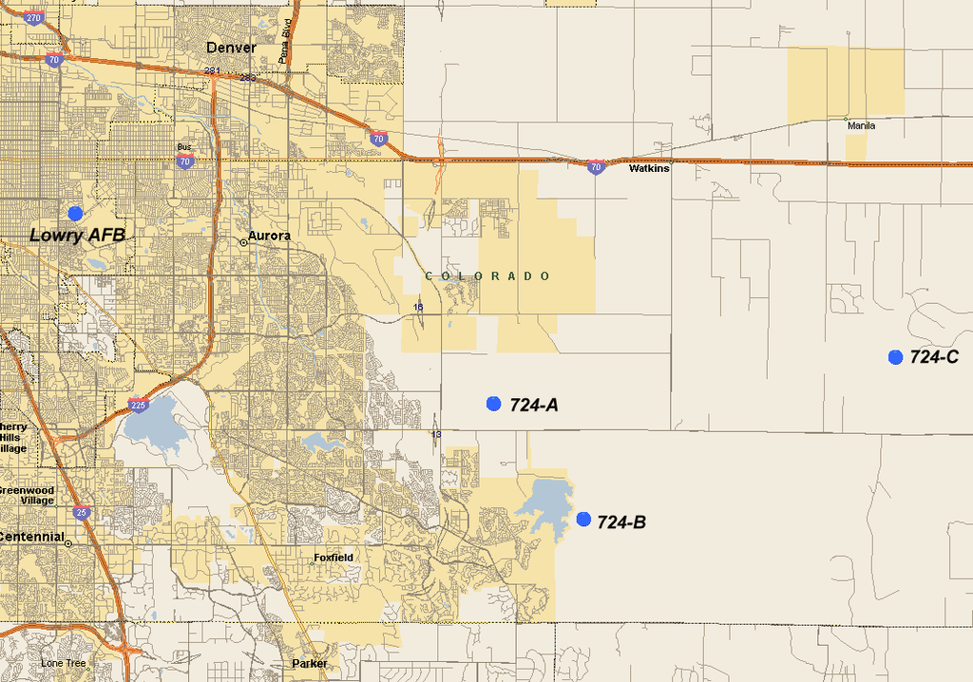
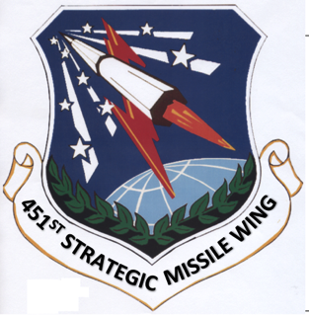
TITAN I – LOWRY AFB, CO
724th Strategic Missile Squadron
Three missiles, one Launch Control Center, and various support buildings per complex with three complexes in the squadron (3x3) dispersed away from each other. The 724th SMS did not have a unit patch, and instead used the 451st SMW patch. Lowry AFB was unique in that it had two Titan I squadrons versus just one like the other bases. The squadron was on-alert from 1962 to 1965.

Slide 43
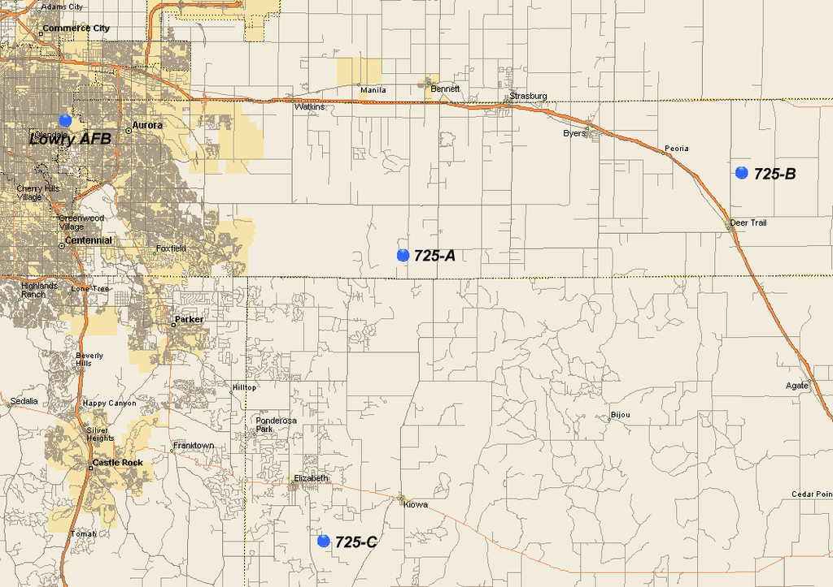
TITAN I – LOWRY AFB, CO
725th Strategic Missile Squadron
Three missiles, one Launch Control Center, and various support buildings per complex with three complexes in the squadron (3x3) dispersed away from each other. The 725th SMS did not have a unit patch, and instead used the 451st SMW patch. Lowry AFB was unique in that it had two Titan I squadrons versus just one like the other bases. The squadron was on-alert from 1962 to 1965.

Slide 44
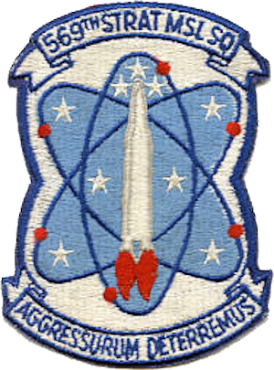
TITAN I – MOUNTAIN HOME AFB, ID
569th Strategic Missile Squadron
Three missiles, one Launch Control Center, and various support buildings per complex with three complexes in the squadron (3x3) dispersed away from each other. The squadron was on-alert from 1962 to 1965.

Slide 45
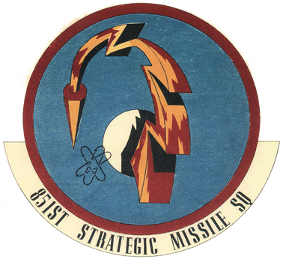
TITAN I – BEALE AFB, CA
851st Strategic Missile Squadron
Three missiles, one Launch Control Center, and various support buildings per complex with three complexes in the squadron (3x3) dispersed away from each other. The squadron was on-alert from 1962 to 1965.

Slide 46
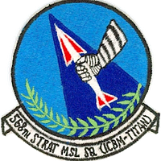
TITAN I – LARSON AFB, WA
568th Strategic Missile Squadron
Three missiles, one Launch Control Center, and various support buildings per complex with three complexes in the squadron (3x3) dispersed away from each other. The squadron was on-alert from 1962 to 1965.

Slide 47
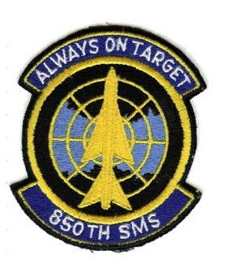
TITAN I – ELLSWORTH AFB, SD
850th Strategic Missile Squadron
Three missiles, one Launch Control Center, and various support buildings per complex with three complexes in the squadron (3x3) dispersed away from each other. The squadron was on-alert from 1962 to 1965.

Slide 48
TITAN I
An overview of the enormous Titan I complex. The three missile silos are in the background. The Launch Control Center is the circular building on the left, the powerhouse is the circular building on the right, and the two antenna silos are in the foreground. All buildings were connected with underground tunnels.

Slide 49
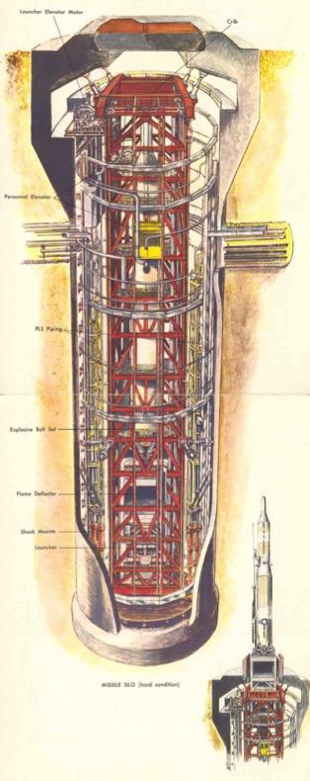
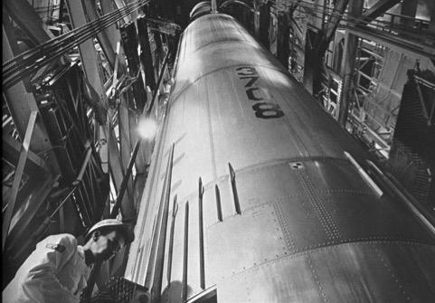
TITAN I
Looking up a Titan I missile silo.
Looking down into a Titan I missile silo.
A diagram of a Titan I missile silo.

Slide 50
TITAN I
The sequence of events from the missile silo doors closed, being opened, and the Titan I being raised to the surface via an elevator. The missile was fueled prior to being elevated to the surface. Once on the surface, the missile could then be launched.

Slide 51
TITAN I
Diagram demonstrating how the Titan I radio inertial guidance system worked. The missile would send location signals down to the ground-based radio antenna, which would then in turn provide course correction information via radio signal.

Slide 52
TITAN I
A Titan I crew sitting at their consoles in the Control Center.

Slide 53
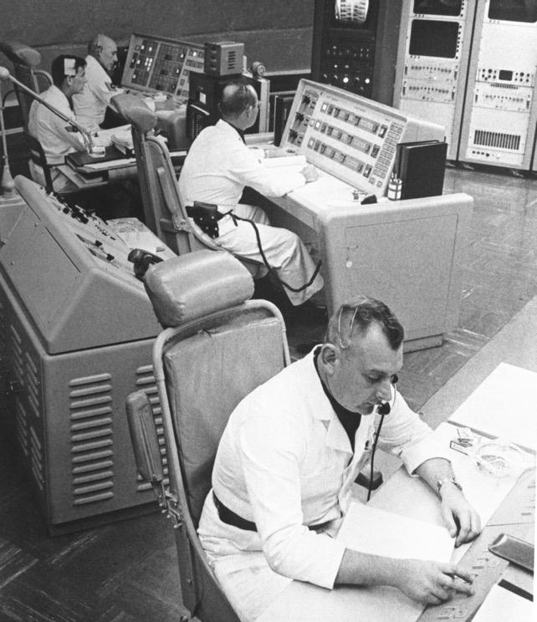
TITAN I
The view down one of several tunnels connecting the various underground buildings within the Titan I complex.
A Titan I crew at their consoles in the Control Center.

Slide 54
TITAN II – 54 DEPLOYED
Missile: LGM-25C
Fuel: Storable Liquid Propellant
Warhead: One Mk-6
Guidance: All-Inertial
Site Plan: One Missile Silo and one Launch Control Center per complex
Deployment: One missile per complex with nine complexes per squadron (1 x 9)
Launch Mode: Hot launched from within silo
Crew Size: Four; Missile Combat Crew Commander, Deputy Missile Combat Crew Commander, Ballistic Missile Analyst Technician, Missile Facilities Technician
Interesting Facts: Titan II used storable liquid propellant which meant it did not have to be fueled prior to launch. A missile could stay fueled for years. This gave it a quicker reaction time than previous liquid-fueled ICBMs. Between 1967 to 1969 the 395th SMS placed Titan II missiles on alert between the three Titan II complexes located at Vandenberg AFB normally reserved for test launches. This was done on a rotational basis to test the feasibility of keeping additional Titan IIs on alert along with the day-to-day alert force.
Davis-Monthan AFB, AZ 1963-1984 570 SMS, 571 SMS
McConnell AFB, KS 1963-1986 532 SMS, 533 SMS
Little Rock AFB, AR 1963-1987 373 SMS, 374 SMS

Slide 55
TITAN II DEPLOYED LOCATIONS
McConnell
Little Rock
Davis-Monthan

Slide 56
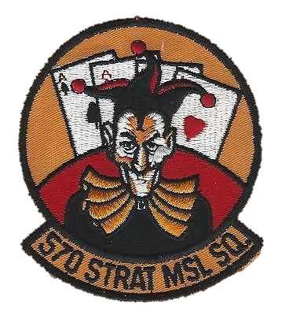
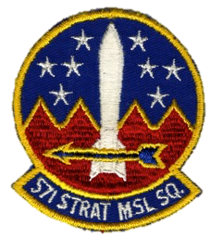
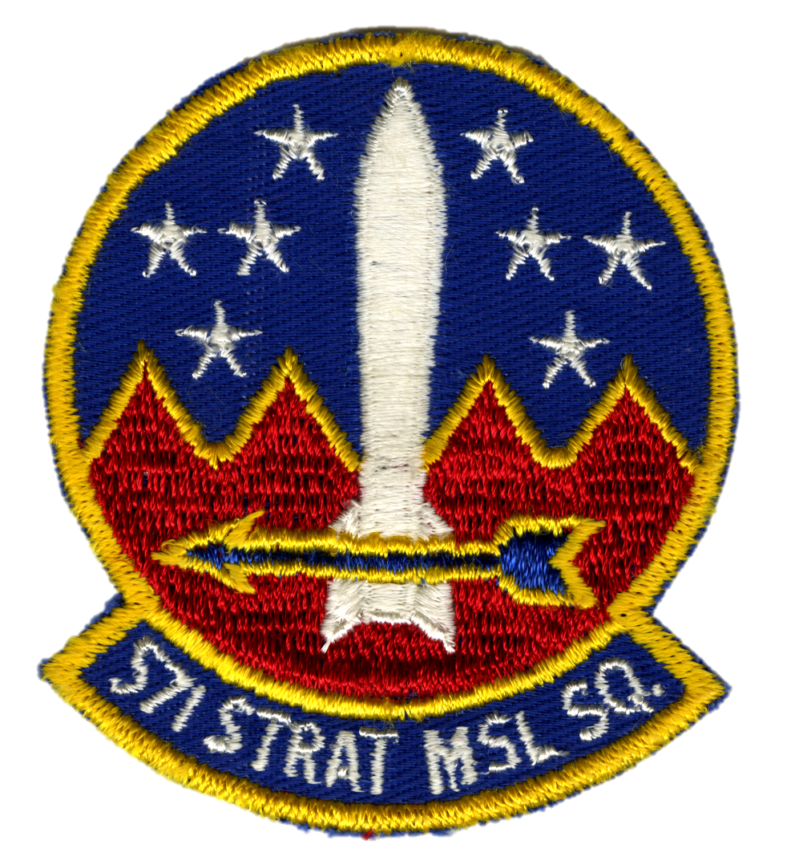
TITAN II – DAVIS-MONTHAN AFB, AZ
570th Strategic Missile Squadron
One missile and one Launch Control Center per complex with nine complexes in the squadron (1x9) dispersed away from each other. The squadron was on-alert from 1963 to 1984.
571st Strategic Missile Squadron
One missile and one Launch Control Center per complex with nine complexes in the squadron (1x9) dispersed away from each other. The squadron was on-alert from 1963 to 1984. Site 571-7 is now the Titan II museum and can be toured today.

Slide 57
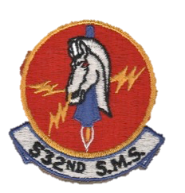
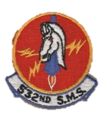
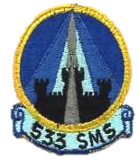
TITAN II – MCCONNELL AFB, KS
532nd Strategic Missile Squadron
One missile and one Launch Control Center per complex with nine complexes in the squadron (1x9) dispersed away from each other. The squadron was on-alert from 1963 to 1986.
533rd Strategic Missile Squadron
One missile and one Launch Control Center per complex with nine complexes in the squadron (1x9) dispersed away from each other. The squadron was on-alert from 1963 to 1986.

Slide 58
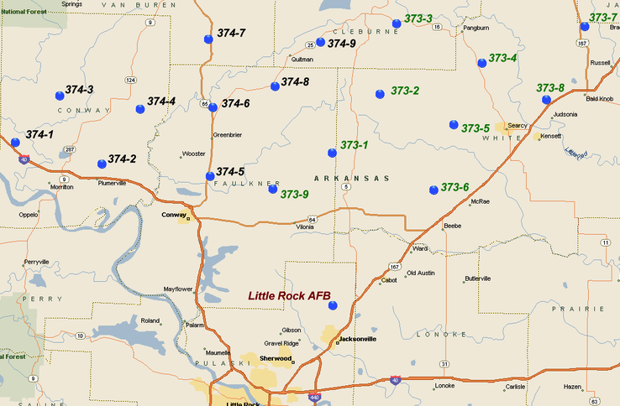
TITAN II – LITTLE ROCK AFB, AR
373rd Strategic Missile Squadron
One missile and one Launch Control Center per complex with nine complexes in the squadron (1x9) dispersed away from each other. The squadron was on-alert from 1963 to 1987.
374th Strategic Missile Squadron
One missile and one Launch Control Center per complex with nine complexes in the squadron (1x9) dispersed away from each other. The squadron was on-alert from 1963 to 1987.

Slide 59
TITAN II
A Titan II complex. The Launch Control Center is on the left, the access portal is in the middle, and the missile silo is on the right.

Slide 60
TITAN II
An aerial view of a typical Titan II site.

Slide 61
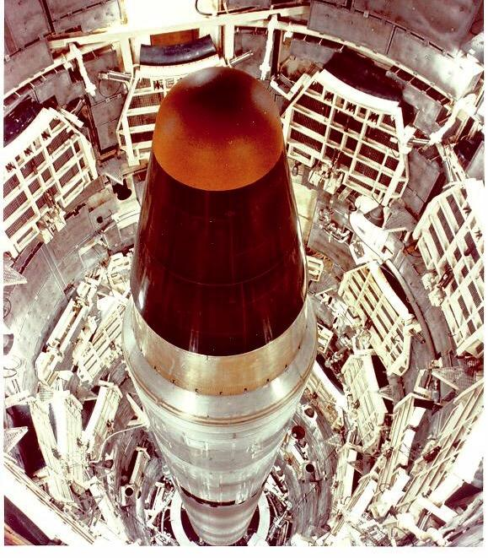
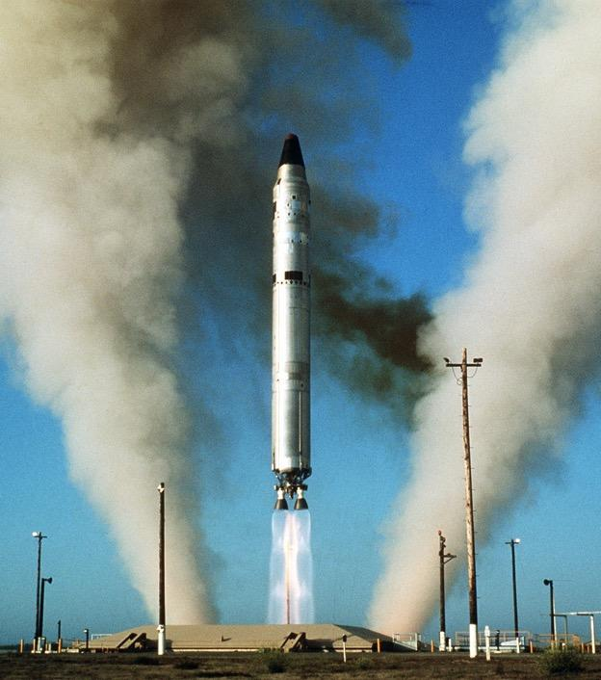
TITAN II
A Titan II on-alert in its silo.
A Titan II launching from its silo. Note the two streams of exhaust and steam. Prior to launch, water was pumped into the bottom of the silo to help deaden the sound and prevent the missile from being damaged. As soon as the engines were ignited, the water instantly turned to steam.

Slide 62
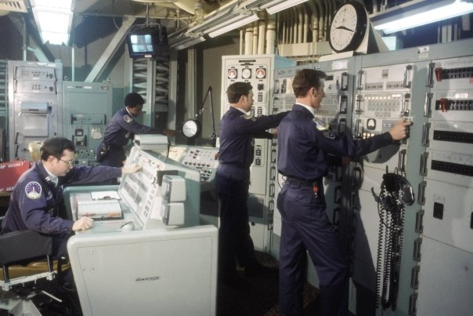
TITAN II
A 373rd SMS Titan II going through a simulated launch procedure. The Missile Combat Crew Commander is on the left, the Deputy Missile Combat Crew Commander is in the background, and the Ballistic Missile Analyst Technician and Missile Facilities Technician are both on the right. Missileers transitioned from the white coveralls uniform seen in previous slides to the two-piece blue uniform, seen here, in 1967.

Slide 63
TITAN II
A 532nd SMS Titan II crew in the Launch Control Center of site 532-9. This site also doubled as the
381st Strategic Missile Wing’s Alternate Command Post. Officers on ICBM crews were armed with Smith & Wesson Model 15 .38 caliber pistols anytime there were visitors inside the complex.

Slide 64
MINUTEMAN IA – 142 DEPLOYED
Missile: LGM-30A (originally SM-80)
Fuel: Solid Propellant
Warhead: One Mk-5
Guidance: All-Inertial
Deployment: 50 Launch Facilities and five Launch Control Centers per squadron that were hardened and dispersed 3-5 miles from each other and interconnected via underground cables.
Site Plan: One missile per Launch Facility. The Launch Control Center was supported by an above ground Launch Control Facility with support equipment located above ground.
Launch Mode: Hot launch from within silo
Command & Control: Primary: ground Missile Combat Crews, Backup: airborne Missile Combat Crews
Crew Size: Two; Missile Combat Crew Commander and Deputy Missile Combat Crew Commander
Interesting Facts: Due to its weight, the Minuteman IA had a known reduced range issue (4800 nm vs. required 5500 nm). However, due to the urgency of putting Minuteman on alert in light of the Soviet threat, it was decided it was more prudent to put the Minuteman IA on alert quicker and fix the range issue later rather than wait for the issue to be fixed. Malmstrom AFB, MT was selected as the first Minuteman base because of its location in the far north and its higher elevation. The elevation provided additional range for the Minuteman IA due to the lower air density it had to fly through during its early stages of flight. The 10 SMS was the first Minuteman squadron to go on alert during the 1962 Cuban Missile Crisis and is known as America’s “First Ace in the Hole”. Sites A-01 and A-06 were the first sites to be placed on strategic alert on 27 October 1962.
Malmstrom AFB, MT 1962-1969 10 SMS, 12 SMS, 490 SMS

Slide 65
MINUTEMAN IA DEPLOYED LOCATION
Malmstrom
Wing I
Minuteman ICBM Wings were designated in sequence as they were built.
Wing I: Malmstrom AFB, MT
Wing II: Ellsworth AFB, SD
Wing III: Minot AFB, ND
Wing IV: Whiteman AFB, MO
Wing V: F.E. Warren AFB, WY
Wing VI: Grand Forks AFB, ND

Slide 66
MINUTEMAN IB – 658 DEPLOYED
Missile Designation: LGM-30B
Fuel: Solid Propellant
Warhead: One Mk-5 or Mk-11
Guidance: All-Inertial
Deployment: 50 Launch Facilities and five Launch Control Centers per squadron that were hardened and dispersed 3-5 miles from each other and interconnected via underground cables.
Site Plan: One missile per Launch Facility. The Launch Control Center was supported by an above ground Launch Control Facility with critical support equipment either located above or below ground, depending on the Wing.
Launch Mode: Hot launch from within silo
Command & Control: Primary: ground Missile Combat Crews, Backup: airborne Missile Combat Crews
Crew Size: Two; Missile Combat Crew Commander and Deputy Missile Combat Crew Commander
Interesting Fact: The Minuteman IB fixed the reduced range issue that affected the Minuteman IA by using lighter materials during construction of the missile. The 490th SMS is unique in that it’s the only squadron to have deployed both Minuteman IA and Minuteman IB missiles...as well as Minuteman II and Minuteman III missiles later on; making it the only ICBM squadron to have deployed all four variants of the Minuteman missile.
Malmstrom AFB, MT 1963*-1969 490 SMS
Ellsworth AFB, SD 1963-1973 66 SMS, 67 SMS, 68 SMS
Minot AFB, ND 1963-1971 740 SMS, 741 SMS, 742 SMS
Whiteman AFB, MO 1964-1967 508 SMS, 509 SMS, 510 SMS
F. E. Warren AFB, WY 1964-1975 319 SMS, 320 SMS, 321 SMS, 400 SMS
*While Malmstrom AFB was in the process of bringing all 150 launch facilities on alert, the last 8 missiles to be installed in the 490th SMS were Minuteman IB missiles. The 10 SMS and 12 SMS never converted to Minuteman IB missiles since they converted straight to Minuteman II missiles.

Slide 67
MINUTEMAN IB DEPLOYED LOCATIONS
Malmstrom
Wing I
Minot
Wing III
Ellsworth
Wing II
F. E. Warren
Wing V
Whiteman
Wing IV
Minuteman ICBM Wings were designated in sequence as they were built.
Wing I: Malmstrom AFB, MT
Wing II: Ellsworth AFB, SD
Wing III: Minot AFB, ND
Wing IV: Whiteman AFB, MO
Wing V: F.E. Warren AFB, WY
Wing VI: Grand Forks AFB, ND

Slide 68
MINUTEMAN II – 450 DEPLOYED
Missile Designation: LGM-30F
Fuel: Solid
Warhead: One Mk-11
Guidance: All-Inertial
Deployment: 50 Launch Facilities and five Launch Control Centers per squadron that were hardened and dispersed 3-5 miles from each other and interconnected via underground cables. The Sylvania-built squadrons at Grand Forks and the 564 SMS at Malmstrom also had Medium Frequency radio interconnectivity between each site.
Site Plan: One missile per Launch Facility. The Launch Control Center was supported by an above ground Launch Control Facility (later Missile Alert Facility) with critical support equipment either located above or below ground, depending on the Wing.
Launch Mode: Hot launch from within silo
Command & Control: Primary: ground Missile Combat Crews, Backup: airborne Missile Combat Crews
Crew Size: Two; Missile Combat Crew Commander and Deputy Missile Combat Crew Commander
Interesting Facts: The Minuteman II was originally designed for the missile sites built by Sylvania, but later retrofitted into the Boeing Minuteman sites. The 510th SMS had ten missiles with their nuclear warheads removed and retrofitted with the Emergency Rocket Communications System (ERCS) for post-attack communications with nuclear forces.
Grand Forks AFB, ND 1966-1973 446 SMS, 447 SMS, 448 SMS
Malmstrom AFB, MT 1967*-1991 10 SMS, 12 SMS, 490 SMS, 564 SMS
Whiteman AFB, MO 1966-1991 508 SMS, 509 SMS, 510 SMS
Ellsworth AFB, SD 1971-1991 66 SMS, 67 SMS, 68 SMS
* The Minuteman II was first put on alert in the 564 SMS in 1967, while the other Malmstrom squadrons began converting from Minuteman I to Minuteman II that same year.

Slide 69
MINUTEMAN II DEPLOYED LOCATIONS
Malmstrom
Wing I
Squadron XX
Grand Forks
Wing VI
Ellsworth
Wing II
Whiteman
Wing IV
Minuteman ICBM Wings were designated in sequence as they were built.
Wing I: Malmstrom AFB, MT
Wing II: Ellsworth AFB, SD
Wing III: Minot AFB, ND
Wing IV: Whiteman AFB, MO
Wing V: F.E. Warren AFB, WY
Wing VI: Grand Forks AFB, ND

Slide 70
MINUTEMAN III – 550 DEPLOYED
Missile Designation: LGM-30G
Fuel: Solid propellant in rocket boosters/storable liquid propellant in post-boost control system
Warhead: One, two, or three Mk-12 (retired), Mk-12A, or Mk-21
Guidance: All-Inertial
Deployment: 50 Launch Facilities and five Launch Control Centers per squadron that were hardened and dispersed 3-5 miles from each other and interconnected via underground cables. The Sylvania-built squadrons at Grand Forks and the 564 SMS at Malmstrom also had Medium Frequency radio interconnectivity between each site.
Site Plan: One missile per Launch Facility. The Launch Control Center was supported by an above ground Launch Control Facility (known as a Missile Alert Facility today) with critical support equipment either located above or below ground, depending on the Wing.
Launch Mode: Hot launch from within silo
Command & Control: Primary: ground Missile Combat Crews, Backup: airborne Missile Combat Crews
Crew Size: Two; Missile Combat Crew Commander and Deputy Missile Combat Crew Commander
Minot AFB, ND 1970-present 740 SMS/MS, 741 SMS/MS, 742 SMS/MS
Grand Forks AFB, ND 1971-1998 446 SMS/MS, 447 SMS/MS, 448 SMS/MS
F. E. Warren AFB, WY 1972-present 319 SMS/MS, 320 SMS/MS, 321 SMS, 400 SMS*
Malmstrom AFB, MT 1975**-present*** 10 SMS/MS, 12 SMS/MS, 490 SMS,/MS, 564 SMS/MS
*The 400 SMS ceased Minuteman III operations in 1988 when it was completely converted to Peacekeeper missiles.
**The Minuteman III was first deployed in the 564 SMS starting in 1975, but the remaining squadrons did not receive their Minuteman IIIs until between 1994-1998.
***The 564 MS was removed from alert in 2007 and was deactivated a year later in 2008. The remaining squadrons remain on alert to this day.

Slide 71
MINUTEMAN III DEPLOYED LOCATIONS
Malmstrom
Wing I
Minot
Wing III
Grand Forks
Wing VI
F. E. Warren Wing V
Minuteman ICBM Wings were designated in sequence as they were built.
Wing I: Malmstrom AFB, MT
Wing II: Ellsworth AFB, SD
Wing III: Minot AFB, ND
Wing IV: Whiteman AFB, MO
Wing V: F.E. Warren AFB, WY
Wing VI: Grand Forks AFB, ND

Slide 72
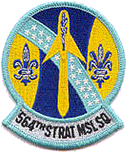
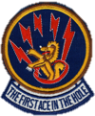
WING I – MALMSTROM AFB, MT
10th Strategic Missile Squadron
Redesignated as the 10th Missile Squadron in 1991. The 10th was the first Minuteman squadron to go on alert during the Cuban Missile Crisis in October 1962 and remains operational to this day. The squadron has operated the Minuteman IA, Minuteman II, and Minuteman III.
12th Strategic Missile Squadron
Redesignated as the 12th Missile Squadron in 1991. The squadron first went on alert in 1963 and remains operational to this day. The squadron has operated the Minuteman IA, Minuteman II, and Minuteman III.
490th Strategic Missile Squadron
Redesignated as the 490th Missile Squadron in 1991. The squadron first went on alert in 1963 and remains operational to this day. The squadron has operated the Minuteman IA, Minuteman IB, Minuteman II, and Minuteman III; the only squadron to have operated all four variants of the Minuteman ICBM.
564th Strategic Missile Squadron
Redesignated as the 564th Missile Squadron in 1991. The squadron first went on alert in 1967 as the last of the Sylvania-built Minuteman II squadrons and was taken off alert in 2007; later deactivated in 2008. The squadron operated the Minuteman II and Minuteman III.

Slide 73
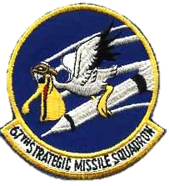
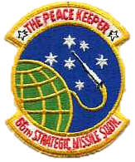
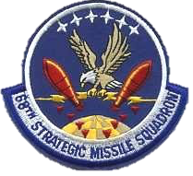
WING II – ELLSWORTH AFB, SD
66th Strategic Missile Squadron
Redesignated as the 66th Missile Squadron in 1991. The squadron first went on alert in 1963 and was taken off-alert in September 1991. The squadron operated the Minuteman IB and Minuteman II. Two of its former facilities (D-01 and D-09) are now museum sites with the National Park Service and can be toured today.
67th Strategic Missile Squadron
Redesignated as the 67th Missile Squadron in 1991. The squadron first went on alert in 1963 and was taken off-alert in September 1991. The squadron operated the Minuteman IB and Minuteman II.
68th Strategic Missile Squadron
Redesignated as the 68th Missile Squadron in 1991. The squadron first went on alert in 1963 and was taken off-alert in September 1991. The squadron operated the Minuteman IB and Minuteman II.

Slide 74
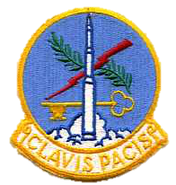
WING III – MINOT AFB, ND
740th Strategic Missile Squadron
Redesignated as the 740th Missile Squadron in 1991. The squadron first went on alert in 1963 and remains operational to this day. The squadron has operated the Minuteman IB and Minuteman III.
741st Strategic Missile Squadron
Redesignated as the 741st Missile Squadron in 1991. The squadron first went on alert in 1964 and remains operational to this day. The squadron has operated the Minuteman IB and Minuteman III. It was the first Minuteman squadron to convert to the Minuteman III in 1970.
742nd Strategic Missile Squadron
Redesignated as the 742nd Missile Squadron in 1991. The squadron first went on alert in 1964 and remains operational to this day. The squadron has operated the Minuteman IB and Minuteman III.

Slide 75
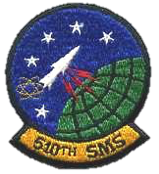
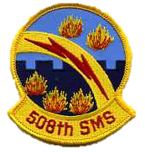
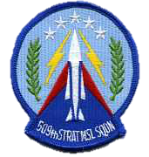
WING IV – WHITEMAN AFB, MO
508th Strategic Missile Squadron
Redesignated as the 508th Missile Squadron in 1991. The squadron first went on alert in 1964 and was taken off-alert in September 1991. The squadron operated the Minuteman IB and Minuteman II.
509th Strategic Missile Squadron
Redesignated as the 509th Missile Squadron in 1991. The squadron first went on alert in 1964 and was taken off-alert in September 1991. The squadron operated the Minuteman IB and Minuteman II. Normal Minuteman squadron flights were designated A-E, F-J, K-O, however due to high water tables and last minute construction changes of where sites were located, the 509th’s flights were actually: G, H, J, K, L.
510th Strategic Missile Squadron
Redesignated as the 510th Missile Squadron in 1991. The squadron first went on alert in 1964 and was taken off-alert in September 1991. The squadron operated the Minuteman IB and Minuteman II. It was unique in the fact that it had ten missiles with their nuclear warheads removed and retrofitted with the Emergency Rocket Communications System (ERCS) for post-attack communications with nuclear forces. Normal Minuteman squadron flights were designated A-E, F-J, K-O, however due to high water tables and last minute construction changes of where sites were located, the 510th’s flights were actually: F, I, M, N, O. The 510th was also unique in that it was the only squadron to have one of its Launch Control Facilities (O-01) located on base. O-01 was also preserved as a museum that can be toured today.

Slide 76
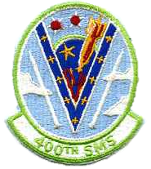
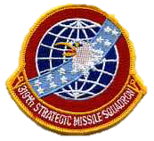
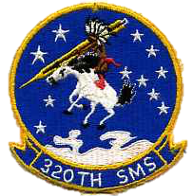
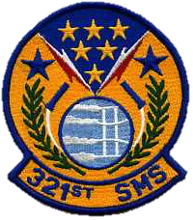
WING V – F.E. WARREN AFB, WY
319th Strategic Missile Squadron
Redesignated as the 319th Missile Squadron in 1991. The squadron first went on alert in 1964 and remains operational to this day. The squadron has operated the Minuteman IB and Minuteman III.
320th Strategic Missile Squadron
Redesignated as the 320th Missile Squadron in 1991. The squadron first went on alert in 1964 and remains operational to this day. The squadron has operated the Minuteman IB and Minuteman III.
321st Strategic Missile Squadron
Redesignated as the 321st Missile Squadron in 1991. The squadron first went on alert in 1965 and remains operational to this day. The squadron has operated the Minuteman IB and Minuteman III.
400th Strategic Missile Squadron
The 400th was the last Boeing-built squadron to go on alert in 1965. It began being converted to a Peacekeeper ICBM squadron in 1986 and ceased Minuteman III operations in 1988 when the conversion was complete. The squadron operated the Minuteman IB and then Minuteman III prior to converting to the Peacekeeper ICBM. Former site Q-01 Missile Alert Facility is now preserved as a museum with the Wyoming State Historic Sites.

Slide 77
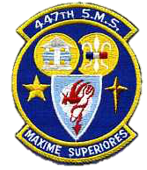
WING VI – GRAND FORKS AFB, ND
446th Strategic Missile Squadron
Redesignated as the 446th Missile Squadron in 1991. The 446th was a Sylvania-built squadron first going on alert with the Minuteman II in 1966 and was taken off-alert in 1997. It transferred its Minuteman III missiles to Malmstrom AFB in the mid-1990s as it was converting from Minuteman II missiles and the 446th was deactivating. The squadron operated the Minuteman II and Minuteman III.
447th Strategic Missile Squadron
Redesignated as the 447th Missile Squadron in 1991. The 447th was a Sylvania-built squadron first going on alert with the Minuteman II in 1966 and was taken off-alert in 1998. It transferred its Minuteman III missiles to Malmstrom AFB in the mid-1990s as it was converting from Minuteman II missiles and the 447th was deactivating. The squadron operated the Minuteman II and Minuteman III.
448th Strategic Missile Squadron
Redesignated as the 448th Missile Squadron in 1991. The 448th was a Sylvania-built squadron first going on alert with the Minuteman II in 1966 and was taken off-alert in 1997. It transferred its Minuteman III missiles to Malmstrom AFB in the mid-1990s as it was converting from Minuteman II missiles and the 448th was deactivating. The squadron operated the Minuteman II and Minuteman III. Two of its former facilities (O-0 and N-33) are now museum sites with the State Historical Society of North Dakota and can be toured today.

Slide 78
MINUTEMAN EVOLUTION
Wings III, IV, & V (WS-133A/M)
-Minot AFB, ND
-Whiteman AFB, MO
-F.E. Warren AFB, WY
*Sites were designated A-01 thru T-01
Wings I & II (WS-133A/M)
-Malmstrom AFB, MT
-Ellsworth AFB, SD
*Sites were designated A-01 thru O-01
Wing VI & 564 SMS (WS-133B) -Grand Forks AFB, ND
-Malmstrom AFB, MT
*Sites were designated A-0 thru T-0

Slide 79
MINUTEMAN EVOLUTION – WING I & II
Wings I & II
Malmstrom AFB, MT
Ellsworth AFB, SD
Launch Control Center (LCC)
This is the basic configuration of a Boeing-built Wing I/II configured Launch Control Facility. The support building was above ground along with backup diesel generator, air handlers, and other support equipment. Access below ground was via an elevator shaft way. The Launch Control Center (LCC), aka “capsule”, was by itself. The noticeable difference below ground for a Wing I or II configured site is that the tunnel junction between the elevator and LCC blast door was slightly longer at Wing II.

Slide 80
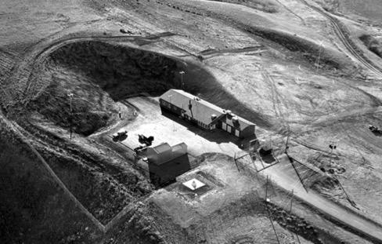
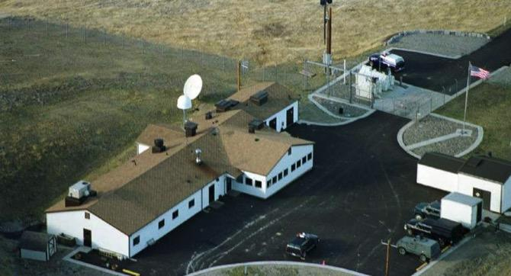
MINUTEMAN EVOLUTION – WING I & II
Wing I Launch Control Facility (LCF) A-01.
The vastness of Montana. Wing I LCF B-01.
Typical Wing I LCF/MAF. How you can distinguish between a Wing I or Wing II LCF is the presence of the water pump house on the opposite side of the parking area of the LCF (right side of photo). Otherwise, the buildings were very similar.
Typical Wing II LCF/MAF. The two Wing configurations were very similar. Pictured here is J-01 at Ellsworth AFB, SD.

Slide 81
MINUTEMAN EVOLUTION – WING I & II
Wing I/II LCCs changed very little over the years. In this circa late 1980s/early 1990s photo, carpet and a bed module can be seen.
An Ellsworth Minuteman II crew. Missileers started transitioning from the two-piece blue uniform to the blue coveralls uniform starting in 1988.
Early Wing I Launch Control Center (LCC).
Wing II LCCs were identical.

Slide 82
MINUTEMAN EVOLUTION – WING III, IV, & V
Wings III, IV, & V
Minot AFB, ND
Whiteman AFB, MO
F.E. Warren AFB, WY
Launch Control Center (LCC)
Launch Control Equipment Building (LCEB)
This is the basic configuration of a Boeing-built Wing III/IV/V configured Launch Control Facility. As time went on it was realized that Minuteman crews may have to “ride out” an attack prior to launching their missiles. Support equipment topside, like Wing I and II, were deemed vulnerable, so the backup diesel generator, air handlers, and other support equipment were moved below ground into a newly built Launch Control Equipment Building (LCEB). The LCEB was protected by a second blast door in front of the elevator. Access below ground was via an elevator shaft way. The Launch Control Center (LCC), aka “capsule”, was almost identical to Wing I and II LCCs.

Slide 83
MINUTEMAN EVOLUTION – WING III, IV, & V
A typical Wing III-V LCF. Original LCFs were painted green. Pictured here is M-01 at Minot AFB, circa late 1960s.
A typical modern day Wing III/V MAF. MAFs were painted tan later in the Cold War. Pictured here is B-01 at Minot AFB, circa late 1990s.

Slide 84
MINUTEMAN EVOLUTION – WING III, IV, & V
Wing III thru V LCCs were identical to Wing I and II LCCs on the inside since they were all designed and built by Boeing.

Slide 85
MINUTEMAN EVOLUTION – WING III, IV, & V
A 742nd SMS MCCC at his console. Note the green lights on the top rows of the indicator panels (one for each of the ten monitored missiles). A green indicator light signified the missile was on Strategic Alert and ready to be launched. A popular missileer saying is “Clean and Green”, meaning all missiles in a flight were on alert with no fault indicator lights illuminated signifying there was an issue with a Launch Facility or missile. Here, a red light can be seen illuminated at the bottom of the indicator panel for LF-07 indicating the Outer Zone security system has been violated. This could either be from an authorized maintenance team on site or an unknown reason, which would trigger an armed response by security forces to investigate the alarm. The MCCC is also armed with a Smith & Wesson Model 15 .38 caliber pistol, which was required anytime the blast door was open and/or there were visitors in the LCC. The requirement for missileers to be armed was dropped prior to 1992.
A modern day LCC view of the Rapid Execution And Combat Targeting (REACT) console. Pictured here is a 740th MS crew at B-01 from Minot AFB, ND. Due to the increasing Soviet threat and the desire to reduce ICBM crew reaction time, as well as the increasing number of re-locatable targets, SAC began the research and development of a rapid message processing and retargeting capability starting on 22 August 1986. Originally named the ICBM Integrated Electronics Upgrade (I2EU), the program was later named REACT. Minuteman LCCs from Wings I, III, and V were upgraded to REACT between 1994 and 1996.

Slide 86
MINUTEMAN EVOLUTION – WING VI & 564 SMS
Wing VI & 564 SMS
Grand Forks AFB, ND
Malmstrom AFB, MT
Launch Control Equipment Building (LCEB)
Launch Control Center (LCC)
This is the basic configuration of a Sylvania-built (WS-133B) Wing VI and 564 SMS configured Launch Control Facility. Based on missileer feedback and different equipment, the Launch Control Center (LCC) was much larger than the Boeing-built LCCs. In addition, the Launch Control Equipment Building (LCEB) was redesigned into a more hardened configuration with its own blast door, just like the LCC. Since Wing VI and the 564 SMS were the first units to get the new Minuteman II missile, they got their nickname of “Deuce”. The nickname stuck even after they converted to the Minuteman III.

Slide 87
MINUTEMAN EVOLUTION – WING VI & 564 SMS
A typical Wing VI/564 SMS LCF. Pictured here is G-0 from the 447th SMS at Grand Forks AFB, ND circa 1980s.
Pictured here is T-0 from the 564th MS at Malmstrom AFB, MT circa 2000s.

Slide 88
MINUTEMAN EVOLUTION – WING VI & 564 SMS
A “Deuce” missileer at the DMCCC console on alert at C-0 from Grand Forks AFB, ND circa 1980s.
A 448th SMS missile crew at the MCCC console.
A “Deuce” missileer at the DMCCC console at T-0 from Malmstrom AFB, MT circa 1970s.

Slide 89
MINUTEMAN EVOLUTION
Wings III, IV, & V (WS-133A/M)
Minot AFB, ND
Whiteman AFB, MO
F.E. Warren AFB, WY
*Sites were designated A-02 thru A-11, B-02 thru B-11, etc.
Wings I & II (WS-133A/M)
-Malmstrom AFB, MT
-Ellsworth AFB, SD
*Sites were designated A-02 thru A-11, B-02 thru B-11, etc.
Wing VI & 564 SMS
-Grand Forks AFB, ND
-Malmstrom AFB, MT
*Sites were designated A-01 thru A-50, B-01 thru B-50, etc.

Slide 90
MINUTEMAN EVOLUTION – WING I THRU V
Typical Boeing-built Wing I thru V Launch Facilities. All operational Minuteman launchers were built facing towards the north, with the Launcher Closure Door (on top of the launcher protecting the missile) opening to the south. The Launch Support Building (LSB) pictured on the right hand side of each illustration was slightly different at Wings I and II. Additionally, at Wing I the LSB was located on the west side of the launcher whereas all of the other wings had it located on the east side. Early on with Wing I, it was discovered that with the prevailing winds mostly coming from the West, the smoke from the backup diesel generator starting in the LSB would be blown across the middle of the launcher causing the electronic outer zone security sensors to detect “movement” and trigger nuisance security alarms. Subsequent wings had the LSB relocated to the east side of the launcher to help alleviate this problem.

Slide 91
MINUTEMAN EVOLUTION – WING I THRU V
A Wing I LF (F-10) at Malmstrom AFB, MT with the latest outer zone security antenna (white pole in middle) circa 1990s. Note the LSB on west side of launcher.
A Wing IV LF (C-04) at Whiteman AFB, MO with the original outer zone security antennas (blue antennas around launcher). Note the LSB on east side of launcher.

Slide 92
MINUTEMAN EVOLUTION – WING VI & 564 SMS
Typical Sylvania-built Wing VI/564 SMS Launch Facility. Improvements were made to the launch tube and launcher equipment room surrounding the missile. However the biggest change was the support equipment normally found in the LSB at Wings I-V was moved into a more hardened, shock isolated, and capsule-shaped Launcher Equipment Building (LEB).

Slide 93
MINUTEMAN EVOLUTION – WING VI & 564 SMS
Typical “Deuce” Sylvania-built Wing VI/564 SMS Launch Facility (LF). Deuce LFs can easily be recognized by the “top hat” vents for both air intake and exhaust of the below ground Launcher Equipment Building (right side of photo). This is an early site so it has the four original “banjo” outer zone security system antennas around the launcher. Starting in the late 1980s, Deuce LFs were upgraded along with all of the Boeing LFs to include the new IMPSS outer zone security system antenna.

Slide 94
MINUTEMAN EVOLUTION
Wings I thru V (WS-133A/M) [Boeing-built]
Every LCC and LF in a squadron were interconnected with each other through a redundant “spider web” of underground cables.
This map shows how typical Boeing-built Minuteman squadrons (Wings I thru V) had their Launch Facilities and Launch Control Centers interconnected via the underground Hardened Intersite Cable System (HICS). There were 50 Launch Facilities and 5 Launch Control Centers per squadron. The squadrons depicted here are the 66th SMS, 67th SMS, and 68th SMS belonging to the 44th Strategic Missile Wing (Wing II).

Slide 95
MINUTEMAN EVOLUTION
Wings VI and 564 SMS (WS-133B) [Sylvania-built]
Every LCC and LF in a squadron were interconnected with each other through a non-redundant network of underground cables. To increase redundancy, a Medium Frequency radio antenna was installed at each site to maintain connectivity in the event the underground cables were severed.
This illustration shows how a Sylvania-built WS-133B LCC of Wing VI and 564 SMS could “talk” with its missiles. The first way was through underground cables indicated here as green lines. The second way was through Medium Frequency radio indicated here as black dashed lines.

Slide 96
MINUTEMAN EVOLUTION

Slide 97
MINUTEMAN EVOLUTION
As the Soviet Union continued its build up of ICBMs in the 1960s, SAC planners realized that in order to prevent the launch of all Minuteman ICBMs, the Soviet Union did not have to destroy all 1000 Minuteman ICBM silos; they only needed to target the 100 Launch Control Centers that controlled the missiles. This would have simplified Soviet war planning. So, the Airborne Launch Control System (ALCS) was developed. It was an emergency launch capability to remotely launch the Minuteman missiles if the underground LCCs were destroyed.
The ALCS was originally installed on modified EC-135 aircraft. These aircraft were essentially flying Minuteman LCCs, hence their name of Airborne Launch Control Center (ALCC). In addition to the other aircrew members onboard, missileers would operate the ALCS and could send the launch signals down to the Minuteman ICBMs via a radio signal. The ALCS is an integral part of the Minuteman command & control system and helps make the Minuteman ICBM survivable.
ALCS first went on alert on 31 May 1967 with EC-135 aircraft. The mission continues to this day with E-6B aircraft. Operating the ALCS is performed by missileers during follow-on assignments after their initial assignments at one of the Missile Wings.
An EC-135A ALCC flying over an Ellsworth LCF.
ALCS crewmembers in front of an E-6B before taking off to test launch a Minuteman ICBM.

Slide 98
MINUTEMAN EVOLUTION
During the Cold War, the ALCS was installed onboard modified EC-135 aircraft. The basic ALCC aircraft used were the EC-135A and EC-135G. Their main mission was to orbit over the Minuteman ICBM fields during wartime and provide launch assistance if needed. The ALCS was also installed on EC-135C Looking Glass aircraft. Today, the ALCC mission is performed by the E-6B Looking Glass aircraft. If LFs lose connectivity with their parent LCCs, then ALCC-configured aircraft can send launch signals down to the Minuteman squadrons via radio signals to remotely launch missiles.

Slide 99
MINUTEMAN EVOLUTION
A Minuteman IB in its launch tube.
A Minuteman II in its launch tube.
A Minuteman III in its launch tube.

Slide 100
PEACEKEEPER
Missile Designation: LGM-118A
Fuel: Solid propellant in rocket boosters/liquid propellant in post-boost control system
Warhead: Ten Mk-21
Guidance: All-Inertial
Deployment: 50 Launch Facilities and five Launch Control Centers per squadron that were hardened and dispersed 3-5 miles from each other and interconnected via underground cables.
Site Plan: One missile per Launch Facility. The Launch Control Center was supported by an above ground Launch Control Facility (later Missile Alert Facility) with critical support equipment located below ground in the Launch Control Equipment Building.
Launch Mode: Cold Launch; gas ejected from silo prior to first stage ignition.
Command & Control: Primary: ground Missile Combat Crews, Backup: airborne Missile Combat Crews
Crew Size: Two; Missile Combat Crew Commander and Deputy Missile Combat Crew Commander
Interesting Facts: The Peacekeeper system was installed into a converted Minuteman squadron (originally Minuteman I and then Minuteman III), so most of the ground equipment was the same as Minuteman, with various upgrades at both the Launch Control Center and Launch Facility to support the newer, more capable, and larger missile.
F. E. Warren AFB 1986-2005 400 SMS/MS

Slide 101
PEACEKEEPER DEPLOYED LOCATION
F. E. Warren

Slide 102
PEACEKEEPER
400th SMS patch circa 1980s.
400th MS patch circa 1990s.
400th MS patch circa 1990s/2000s.
The 400th SMS/MS emblem changed over the years. It originally started out as a modified version of the 400th SMS emblem used during its Minuteman days. It finally ended up using a modified emblem and colors used by the squadron during World War.

Slide 103
PEACEKEEPER
As one can see, the LCC and consoles used by Peacekeeper missileers were identical to those used by Wing I thru V missileers. This is because the 400th SMS was originally a Minuteman I and then Minuteman III squadron. Between 1986 and 1988, the 400th was converted from Minuteman III to Peacekeeper. Although the same facilities and most of the same equipment was reused, there were some slight modifications and new equipment installed to support to Peacekeeper weapon system.

Slide 104
PEACEKEEPER

Slide 105
TREATY IMPACTS
Strategic Arms Limitation Treaty (SALT) I
Placed limits on launchers and prevented additional ICBMs from being built. The US froze at 1054 ICBMs (1000 Minuteman ICBMs and 54 Titan II ICBMs). However, even though more ICBMs could not be built, the overall warhead total increased due to more MIRVed ICBMs coming online on both sides.
Strategic Arms Limitation Treaty (SALT) II
Intended to place additional limits on launchers and limit how many warheads a missile could carry, but treaty was never ratified. However, the US stated it would not violate the un-ratified accords as long as the Soviets did the same.
Strategic Arms Reduction Treaty (START) I
All 450 Minuteman IIs were taken off-alert and their units deactivated, with the exception of Malmstrom AFB, in preparation to comply with the treaty.
Rather than deactivate Malmstrom AFB, the Minuteman IIs were removed and the Minuteman IIIs at Grand Forks AFB were transferred to Malmstrom AFB. Grand Forks AFB was subsequently deactivated.
Strategic Arms Reduction Treaty (START) II
Although the treaty was never ratified by Russia, in anticipation of it entering into force, the US proceeded down the path of retiring the Peacekeeper ICBM and converting all Minuteman III ICBMs to a single-warhead configuration.
F.E. Warren AFB converted all of its Minuteman IIIs to single warheads, but Minot AFB and Malmstrom AFB never fully converted.
New Strategic Arms Reduction Treaty (New START)
Central limits of treaty were no more than 700 deployed launchers; no more than 1550 nuclear warheads on deployed launchers; and no more than 800 total of both deployed and non-deployed launchers.
Each side had the freedom to choose their own force structure as long as the central limits were met.
- The US decided to de-MIRV the remaining MIRVed Minuteman IIIs at both Malmstrom AFB and Minot AFB so that every Minuteman III would have a single warhead. It was also decided to have 50 empty (non-deployed) Launch Facilities which left 400 deployed single-warhead Minuteman III ICBMs on alert. This force structure was intended to give the US more flexibility for hedging and depot level maintenance of Launch Facilities.

Slide 106
THE CURRENT MINUTEMAN ICBM FORCE
AF Missileers: Extraordinary people. Unmatched responsibility. Overwhelming capabilities.

Slide 107
SENTINEL
Missile Designation: LGM-35A
Fuel: Solid rocket boosters/liquid propellant post-boost control system
Warhead: TBD
Guidance: Inertial
Site Plan: TBD, but will be using existing silos at Malmstrom, Minot, and F.E. Warren
Launch Mode: Hot launch from within silo
Command & Control: TBD
Crew Size: TBD
Interesting Facts: Formerly known as the Ground Based Strategic Deterrent (GBSD). Initial deployment scheduled for 2027 with planned Full Operational Capability in 2034.
F.E. Warren AFB, WY 2027-2075* TBD
Malmstrom AFB, MT 2027-2075* TBD
Minot AFB, ND 2027-2075* TBD

